Slide 1
YouTube Downloads
Supplement to ICL PowerPoint 4 Class

Slide 2
Video Sources
YouTube: Largest collection of videos (& Audio)
  Search for specific topics
  Can’t download directly from YouTube
  You can play directly from YouTube:
    Example: https://www.youtube.com/watch?v=oMoymqXB4Cs
    But you have to leave PowerPoint
    You get whatever YouTube plays (e.g., ads)
    Depends on Internet
  3rd Party Software makes downloads possible

Slide 3

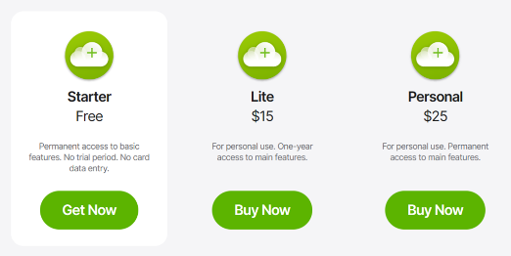
YouTube Downloader
4K Video Downloader
Free personal version (limited but capable for YouTube)
  Paid version: “+” version, no ads, unlimited downloads
  $15 one-time cost, for one year/$25 perpetual license
  Can also extract just audio in MP3 format

Slide 4
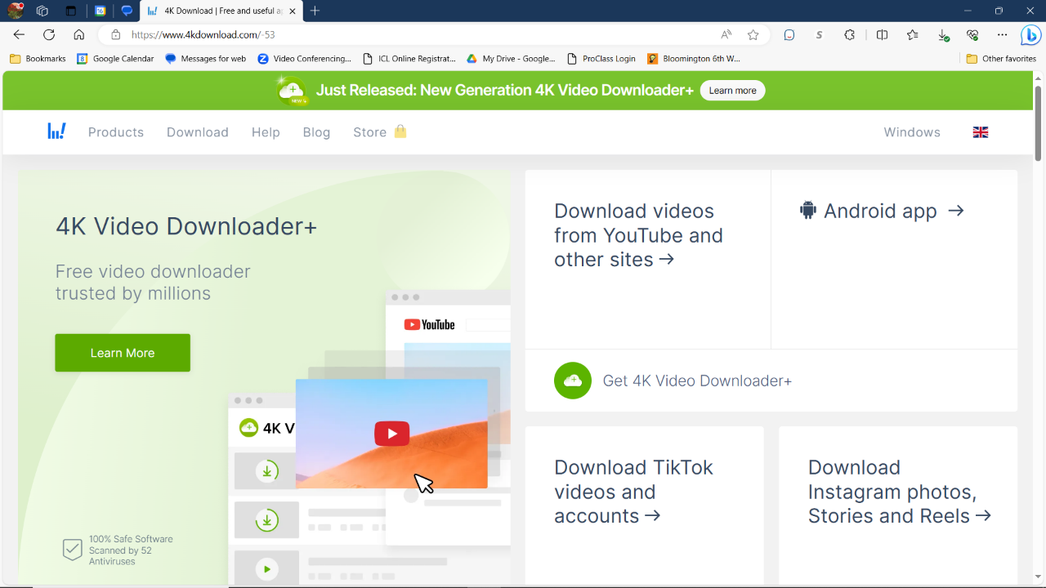
  Get at: https://www.4kdownload.com/
  (Caution: 4Kdownloader.com was a scam site!)

Slide 5
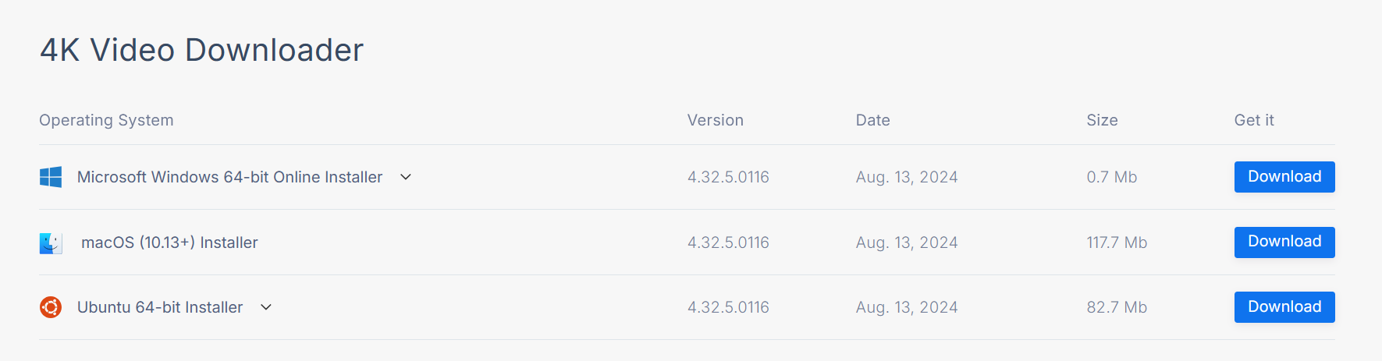
4K Video Downloader
https://www.4kdownload.com/downloads/34#

Slide 6
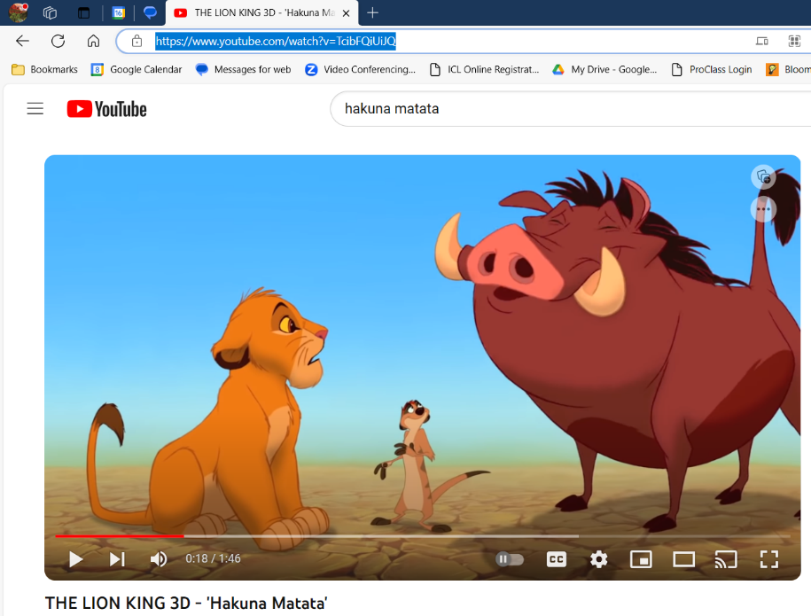

Slide 7
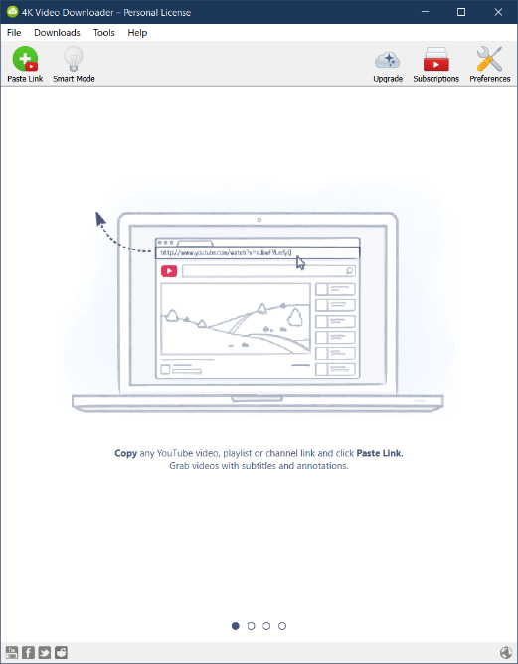
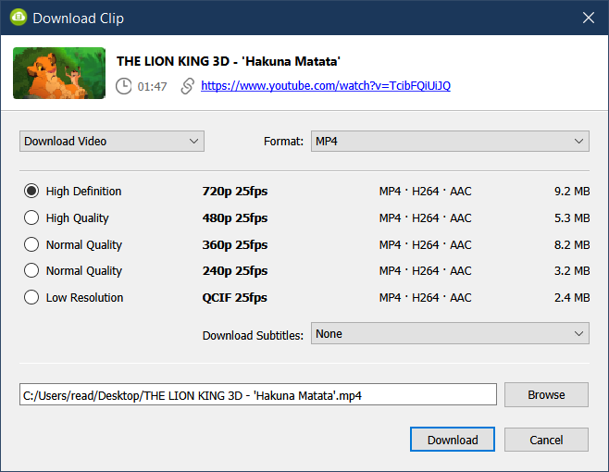
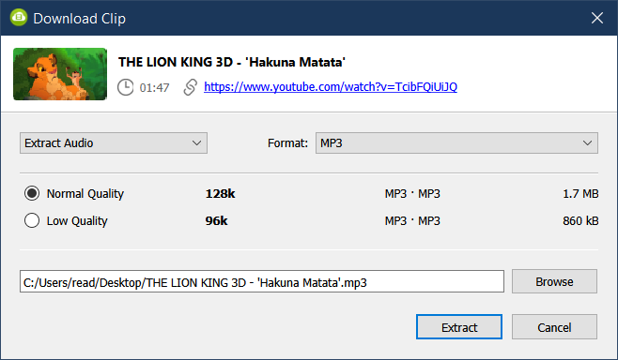
YouTube Downloader

Slide 8
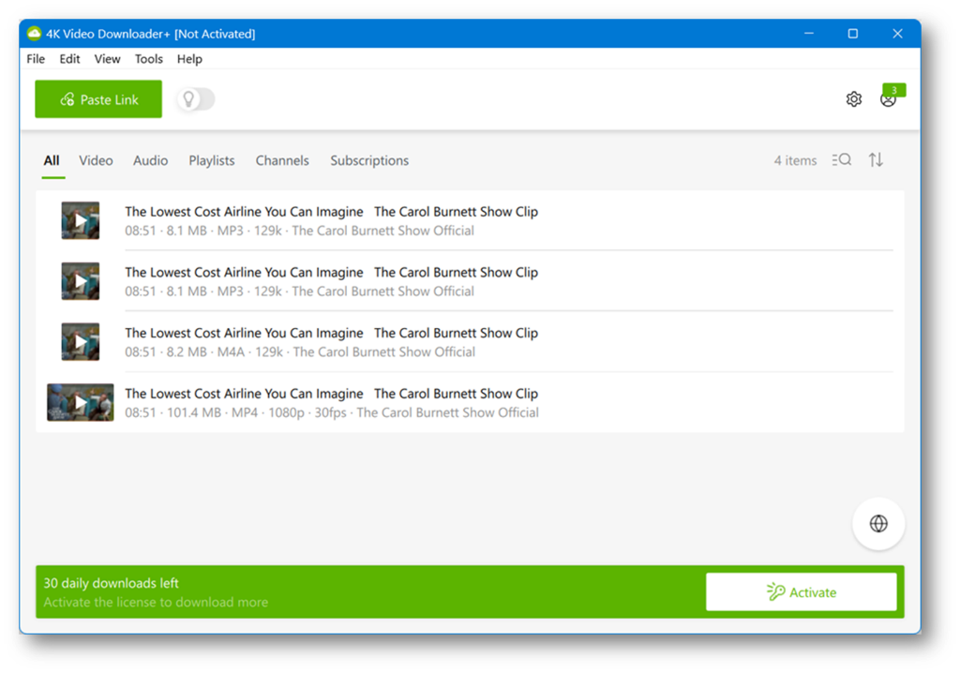

Slide 10
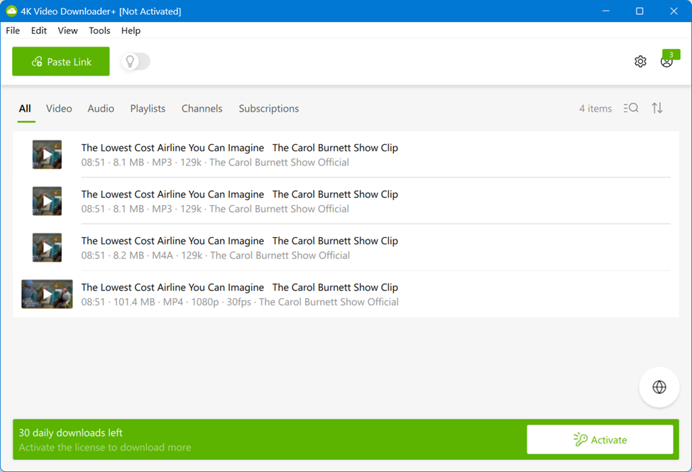
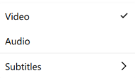
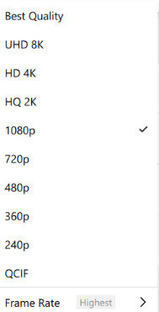
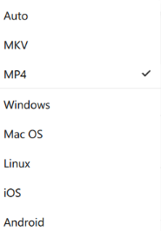
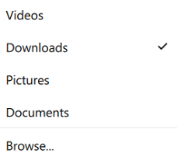

Slide 11
